Slide 1
Murach’s PHP and MySQL (4th Edition)
Chapter 22
How to work with files, uploads, and images

Slide 2
Objectives
Applied
Get data from and save data in files.
Upload and save files from users, including image files.
Create new images, resize images, and work with image transparency.
Knowledge
In general terms, describe the PHP functions for working with directories and files.
Describe the HTML for uploading a file and the PHP function for saving an uploaded file in a permanent directory.
In general terms, describe the PHP functions for working with images, resizing images, and working with image transparency.

Slide 3
Three functions to test if a file or directory exists
is_file($path)
is_dir($path)
file_exists($path)
A function to get the current working directory
getcwd()
A constant that contains the path separator
DIRECTORY_SEPARATOR
A function to get a directory listing
scandir($path)

Slide 4
Display a directory listing
$path = getcwd();
$items = scandir($path);
echo "<p>Contents of $path</p>";
echo '<ul>';
foreach ($items as $item) {
echo '<li>' . $item . '</li>';
}
echo '</ul>';

Slide 5
Display the files from a directory listing
$path = getcwd();
$items = scandir($path);
$files = [];
foreach ($items as $item) {
$item_path = $path . DIRECTORY_SEPARATOR . $item;
if (is_file($item_path)) {
$files[] = $item;
}
}
echo "<p>Files in $path</p>";
echo '<ul>';
foreach ($files as $file) {
echo '<li>' . $file . '</li>';
}
echo '</ul>';

Slide 6
Three functions to read an entire file
Function | Description
file($name) | Returns an array with each element containing one line from the file.
file_get_contents($name) | Returns the contents of the file as a string.
readfile($name) | Reads a file and echoes it to the web page.
A function to write an entire file
Function | Description
file_put_contents($name, $data) | Writes the specified data string to the specified filename.

Slide 7
How to read and write text
Read text from a file
$text = file_get_contents('message.txt');
$text = htmlspecialchars($text);
echo '<div>' . $text . '</div>';
Write text to a file
$text = "This is line 1.\nThis is line 2.\n";
file_put_contents('message.txt', $text);

Slide 8
How to read and write arrays
Read a file into an array
$names = file('usernames.txt');
foreach ($names as $name) {
echo '<div>' . $name . '</div>';
}
Write an array to a file
$names = ['joelmurach', 'rayharris', 'mikemurach'];
$names = implode("\n", $names);
file_put_contents('usernames.txt', $names);

Slide 9
Modes for opening a file with the fopen() function
Mode | Description
'rb' | Opens the file for reading. If the file doesn’t exist, fopen() returns FALSE.
'wb' | Opens the file for writing. If the file exists, the existing data is deleted. If the file doesn’t exist, it is created.
'ab' | Opens the file for writing. If the file exists, the new data is appended. If the file doesn’t exist, it is created.
'xb' | Creates a new file for writing. If the file exists, fopen() returns FALSE.

Slide 10
Functions that open and close a file
Function | Description
fopen($path, $mode) | Opens the specified file with the specified mode and returns a file handle.
feof($file) | Returns TRUE when the end of the specified file is reached.
fclose($file) | Closes the specified file.
Functions that read from and write to a file
Function | Description
fread($file, $length) | Reads up to the specified number of bytes from the specified file.
fgets($file) | Reads a line from the specified file.
fwrite($file, $data) | Writes the specified string data to the specified file.

Slide 11
Read from a file
$file = fopen('usernames.txt', 'rb');
$names = '';
while (!feof($file)) {
$name = fgets($file);
if ($name === false) { continue; }
$name = trim($name);
if (strlen($name) == 0 ||
substr($name, 0, 1) == '#') {
continue;
}
$names .= "<div>" . $name . "</div>\n";
}
fclose($file);
echo $names;

Slide 12
Write to a file
$path = getcwd();
$items = scandir($path);
$file = fopen('listing.txt', 'wb');
foreach ($items as $item) {
$item_path = $path . DIRECTORY_SEPARATOR . $item;
if (is_dir($item_path)) {
fwrite($file, $item . "\n");
}
}
fclose($file);

Slide 13
Functions to copy, rename, and delete files
copy($oldname, $newname)
rename($oldname, $newname)
unlink($name)
Copy a file
$name1 = 'message.txt';
$name2 = 'message_2.txt';
if (file_exists($name1)) {
$success = copy($name1, $name2);
if ($success) {
echo '<div>File was copied.</div>';
}
}

Slide 14
Rename a file
$name2 = 'message_2.txt';
$name3 = 'message_copy.txt';
if (file_exists($name2)) {
$success = rename($name2, $name3);
if ($success) {
echo '<div>File was renamed.</div>';
}
}
Delete a file
$name3 = 'message_copy.txt';
if (file_exists($name3)) {
$success = unlink($name3);
if ($success) {
echo '<div>File was deleted.</div>';
}
}

Slide 15

An HTML form for uploading a file
<form action="upload.php" method="post" enctype="multipart/form-data">
<input type="file" name="file1"><br>
<input type="submit" value="Upload">
</form>
The browser display of the HTML

Slide 16
Elements of the $_FILES array
'name'
'size'
'tmp_name'
'type'
'error'
Common error code values
UPLOAD_ERR_OK (no error)
UPLOAD_ERR_INI_SIZE (file was too large)
UPLOAD_ERR_PARTIAL
A function to save an uploaded file
move_uploaded_file($tmp, $new)

Slide 17
PHP for working with an uploaded file
$tmp_name = $_FILES['file1']['tmp_name'];
$path = getcwd() . DIRECTORY_SEPARATOR . 'images';
$name = $path . DIRECTORY_SEPARATOR .
$_FILES['file1']['name'];
$success = move_uploaded_file($tmp_name, $name);
if ($success) {
$upload_message = $name . ' has been uploaded.';
}

Slide 18
A function that gets information about an image
getimagesize($path)
Common IMAGETYPE constants
IMAGETYPE_JPEG
IMAGETYPE_GIF
IMAGETYPE_PNG
IMAGETYPE_WEBP

Slide 19
PHP that gets information about an image (part 1)
// Set the path to the image
$image_path = getcwd() . DIRECTORY_SEPARATOR .
'gibson_sg.png';
// Get the image width, height, and type
$image_info = getimagesize($image_path);
$image_width = $image_info[0];
$image_height = $image_info[1];
$image_type = $image_info[2];

Slide 20
PHP that gets information about an image (part 2)
// Display the image type
switch($image_type) {
case IMAGETYPE_JPEG:
echo 'This is a JPEG image.<br>';
break;
case IMAGETYPE_GIF:
echo 'This is a GIF image.<br>';
break;
case IMAGETYPE_PNG:
echo 'This is a PNG image.<br>';
break;
case IMAGETYPE_WEBP
echo 'This is a WEBP image.<br>;
break;
default:
echo 'File must be a JPEG, GIF, or PNG image.<br>';
exit;
}

Slide 21
Functions that work with images
Name | Description
imagecreatefromxxx($path) | Creates an image of the xxx type from the specified file path.
imagesx($image) | Returns the width of the specified image.
imagesy($image) | Returns the height of the specified image.
imagexxx($image, $path) | Writes the specified image of the xxx type to the specified file path.
imagedestroy($image) | Frees any memory that’s used for the specified image.

Slide 22
Code that reads and writes an image (part 1)
// Set the paths for the images
$image_path = getcwd() . DIRECTORY_SEPARATOR .
'gibson_sg.png';
$image_path_2 = getcwd() . DIRECTORY_SEPARATOR .
'gibson_sg_2.png';
// Get the image width, height, and type
$image_info = getimagesize($image_path);
$image_type = $image_info[2];

Slide 23
Code that reads and writes an image (part 2)
// Set up the function names for the image type
switch($image_type) {
case IMAGETYPE_JPEG:
$image_from_file = 'imagecreatefromjpeg';
$image_to_file = 'imagejpeg';
break;
case IMAGETYPE_GIF:
$image_from_file = 'imagecreatefromgif';
$image_to_file = 'imagegif';
break;
case IMAGETYPE_PNG:
$image_from_file = 'imagecreatefrompng';
$image_to_file = 'imagepng';
break;
default:
echo 'File must be a JPEG, GIF, or PNG image.';
exit;
}

Slide 24
Code that reads and writes an image (part 3)
// Create a new image from the file
$image = $image_from_file($image_path);
// Check the image's width and height
$image_width = imagesx($image);
$image_height = imagesy($image);
// Write the image to a file
$image_to_file($image, $image_path_2);
// Free any memory associated with the image
imagedestroy($image);

Slide 25
Functions that can resize an image
Name | Description
imagecreatetruecolor($w, $h) | Returns an all-black truecolor image of the specified size.
imagecopyresampled($di, $si, $dx, $dy, $sx, $sy, $dw, $dh, $sw, $sh) | Copies a rectangular portion of the source image (s) to the destination image (d), resizing the image if necessary.

Slide 26
Resizing an image to 100 by 100 pixels maximum (part 1)
// Set some variables
$old_path = getcwd() . DIRECTORY_SEPARATOR .
'gibson_sg.png';
$new_path = getcwd() . DIRECTORY_SEPARATOR .
'gibson_sg_100.png';
$image_type = IMAGETYPE_PNG;
// Get the old image and its height and width
$old_image = imagecreatefrompng($old_path);
$old_width = imagesx($old_image);
$old_height = imagesy($old_image);
// Calculate height and width ratios for 100x100 maximum
$width_ratio = $old_width / 100;
$height_ratio = $old_height / 100;

Slide 27
Resizing an image (part 2)
// If image larger than ratio, create the new image
if ($width_ratio > 1 || $height_ratio > 1) {
// Calculate height and width for the new image
$ratio = max($width_ratio, $height_ratio);
$new_height = round($old_height / $ratio);
$new_width = round($old_width / $ratio);
// Create the new image
$new_image =
imagecreatetruecolor($new_width, $new_height);
// Copy old image to new image to resize the file
$new_x = 0; // Start new image in upper left corner
$new_y = 0;
$old_x = 0; // Copy old image from upper left corner
$old_y = 0;
imagecopyresampled($new_image, $old_image,
$new_x, $new_y, $old_x, $old_y,
$new_width, $new_height,
$old_width, $old_height);

Slide 28
Resizing an image (part 3)
// Write the new image to a file
imagepng($new_image, $new_path);
// Free any memory associated with the new image
imagedestroy($new_image);
}
// Free any memory associated with the old image
imagedestroy($old_image);

Slide 29
Functions that work with image transparency
Name | Description
imagecolorallocatealpha( $i, $r, $g, $b, $a) | Returns an identifier for the transparent (alpha) color of the specified image. The RGB values specify the color. The alpha value specifies the amount of transparency.
imagecolortransparent( $i, $a) | Sets the transparent color in the specified image.
imagealphablending( $i, $f) | To turn alpha blending mode off, set the second parameter to FALSE.
imagesavealpha($i, $f) | To attempt to save full alpha channel information, set the second parameter to TRUE. For this to work, alpha blending mode must be turned off.

Slide 30
Code that works with image transparency
// calculate the width and height for the new image
// and set the image type for the new image
$new_image =
imagecreatetruecolor($new_width, $new_height);
// Set transparency according to image type
if ($image_type == IMAGETYPE_GIF) {
$alpha =
imagecolorallocatealpha($new_image, 0, 0, 0, 127);
imagecolortransparent($new_image, $alpha);
}
if ($image_type == IMAGETYPE_PNG ||
$image_type == IMAGETYPE_GIF) {
imagealphablending($new_image, false);
imagesavealpha($new_image, true);
}
// code that writes the new image to a file

Slide 31
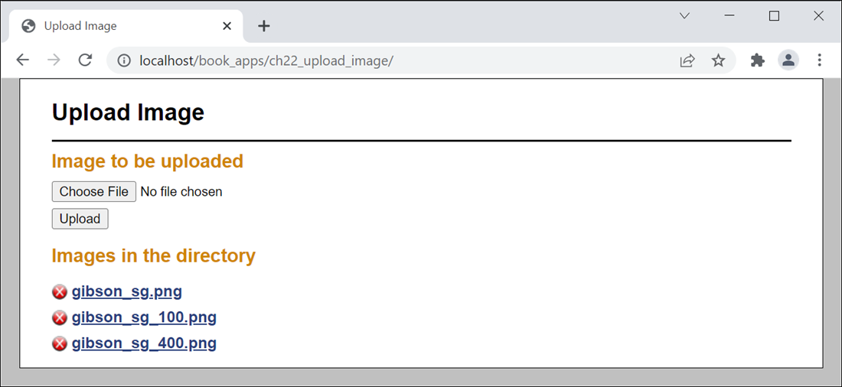
The user interface for the Image Upload app

Slide 32
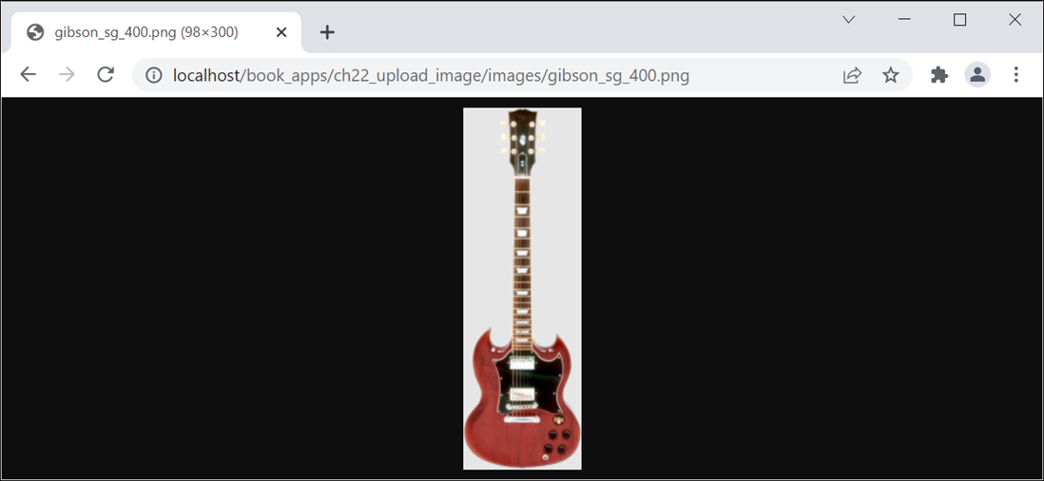
An image displayed in the browser

Slide 33
The file_util.php file
function get_file_list($path) {
$files = [];
if (is_dir($path)) {
$items = scandir($path);
foreach ($items as $item) {
$item_path = $path . DIRECTORY_SEPARATOR .
$item;
if (is_file($item_path)) {
$files[] = $item;
}
}
}
return $files;
}

Slide 34
The image_util.php file (part 1)
<?php
function process_image($dir, $filename) {
// Set up the variables
$dir = $dir . DIRECTORY_SEPARATOR;
$i = strrpos($filename, '.');
$image_name = substr($filename, 0, $i);
$ext = substr($filename, $i);
// Set up the read path
$image_path = $dir . DIRECTORY_SEPARATOR . $filename;
// Set up the write paths
$image_path_400 = $dir . $image_name . '_400' . $ext;
$image_path_100 = $dir . $image_name . '_100' . $ext;
// Create an image that's a maximum of 400x300 pixels
resize_image($image_path, $image_path_400, 400, 300);
// Create a thumbnail image that's 100x100 pixels max
resize_image($image_path, $image_path_100, 100, 100);
}

Slide 35
The image_util.php file (part 2)
function resize_image($old_image_path, $new_image_path,
$max_width, $max_height) {
// Get image type
$image_info = getimagesize($old_image_path);
$image_type = $image_info[2];
// Set up the function names
switch($image_type) {
case IMAGETYPE_JPEG:
$image_from_file = 'imagecreatefromjpeg';
$image_to_file = 'imagejpeg';
break;
case IMAGETYPE_GIF:
$image_from_file = 'imagecreatefromgif';
$image_to_file = 'imagegif';
break;
case IMAGETYPE_PNG:
$image_from_file = 'imagecreatefrompng';
$image_to_file = 'imagepng';
break;
default:
echo 'File must be a JPEG, GIF, or PNG image.';
exit;
}

Slide 36
The image_util.php file (part 3)
// Get the old image and its height and width
$old_image = $image_from_file($old_image_path);
$old_width = imagesx($old_image);
$old_height = imagesy($old_image);
// Calculate height and width ratios
$width_ratio = $old_width / $max_width;
$height_ratio = $old_height / $max_height;

Slide 37
The image_util.php file (part 4)
// If image larger than ratio, create the new image
if ($width_ratio > 1 || $height_ratio > 1) {
// Calculate height and width for the new image
$ratio = max($width_ratio, $height_ratio);
$new_height = round($old_height / $ratio);
$new_width = round($old_width / $ratio);
// Create the new image
$new_image =
imagecreatetruecolor($new_width, $new_height);
// Set transparency according to image type
if ($image_type == IMAGETYPE_GIF) {
$alpha = imagecolorallocatealpha(
$new_image, 0, 0, 0, 127);
imagecolortransparent($new_image, $alpha);
}
if ($image_type == IMAGETYPE_PNG ||
$image_type == IMAGETYPE_GIF) {
imagealphablending($new_image, false);
imagesavealpha($new_image, true);
}

Slide 38
The image_util.php file (part 5)
// Copy old image to new image and resize
$new_x = 0;
$new_y = 0;
$old_x = 0;
$old_y = 0;
imagecopyresampled($new_image, $old_image,
$new_x, $new_y, $old_x, $old_y,
$new_width, $new_height, $old_width, $old_height);
// Write the new image to a new file
$image_to_file($new_image, $new_image_path);
// Free any memory associated with the new image
imagedestroy($new_image);
} else {
// Write the old image to a new file
$image_to_file($old_image, $new_image_path);
}
// Free any memory associated with the old image
imagedestroy($old_image);
}
?>

Slide 39
The controller (index.php) (part 1)
<?php
require_once 'file_util.php'; // get_file_list function
require_once 'image_util.php'; // process_image function
$image_dir = 'images';
$image_dir_path = getcwd() . DIRECTORY_SEPARATOR .
$image_dir;
$action = filter_input(INPUT_POST, 'action');
if ($action == NULL) {
$action = filter_input(INPUT_GET, 'action');
if ($action == NULL) {
$action = '';
}
}

Slide 40
The controller (index.php) (part 2)
switch ($action) {
case 'upload':
if (isset($_FILES['file1'])) {
$filename = $_FILES['file1']['name'];
if (!empty($filename)) {
$source = $_FILES['file1']['tmp_name'];
$target = $image_dir_path .
DIRECTORY_SEPARATOR . $filename;
move_uploaded_file($source, $target);
// create '400' and '100' versions of image
process_image($image_dir_path, $filename);
}
}
break;

Slide 41
The controller (index.php) (part 3)
case 'delete':
$filename = filter_input(INPUT_GET, 'filename',
FILTER_SANITIZE_STRING);
$target = $image_dir_path . DIRECTORY_SEPARATOR .
$filename;
if (file_exists($target)) {
unlink($target);
}
break;
}
$files = get_file_list($image_dir_path);
include('uploadform.php');
?>

Slide 42
The view (uploadform.php) (part 1)
<!DOCTYPE html>
<html>
<head>
<title>Upload Image</title>
<link rel="stylesheet" href="main.css"/>
</head>
<body>
<header>
<h1>Upload Image</h1>
</header>
<main>
<h2>Image to be uploaded</h2>
<form id="upload_form"
action="." method="POST"
enctype="multipart/form-data">
<input type="hidden" name="action" value="upload">
<input type="file" name="file1"><br>
<input id="upload_button" type="submit"
value="Upload">
</form>

Slide 43
The view (uploadform.php) (part 2)
<h2>Images in the directory</h2>
<?php if (count($files) == 0) : ?>
<p>No images uploaded.</p>
<?php else: ?>
<ul>
<?php foreach($files as $filename) :
$file_url = $image_dir . '/' . $filename;
$delete_url =
'.?action=delete&amp;filename=' .
urlencode($filename);
?>
<li>
<a href="<?php echo $delete_url;?>">
<img src="delete.png" alt="Delete"></a>
<a href="<?php echo $file_url; ?>">
<?php echo $filename; ?></a>
</li>
<?php endforeach; ?>
</ul>
<?php endif; ?>
</main>
</body>
</html>

